Slide 1
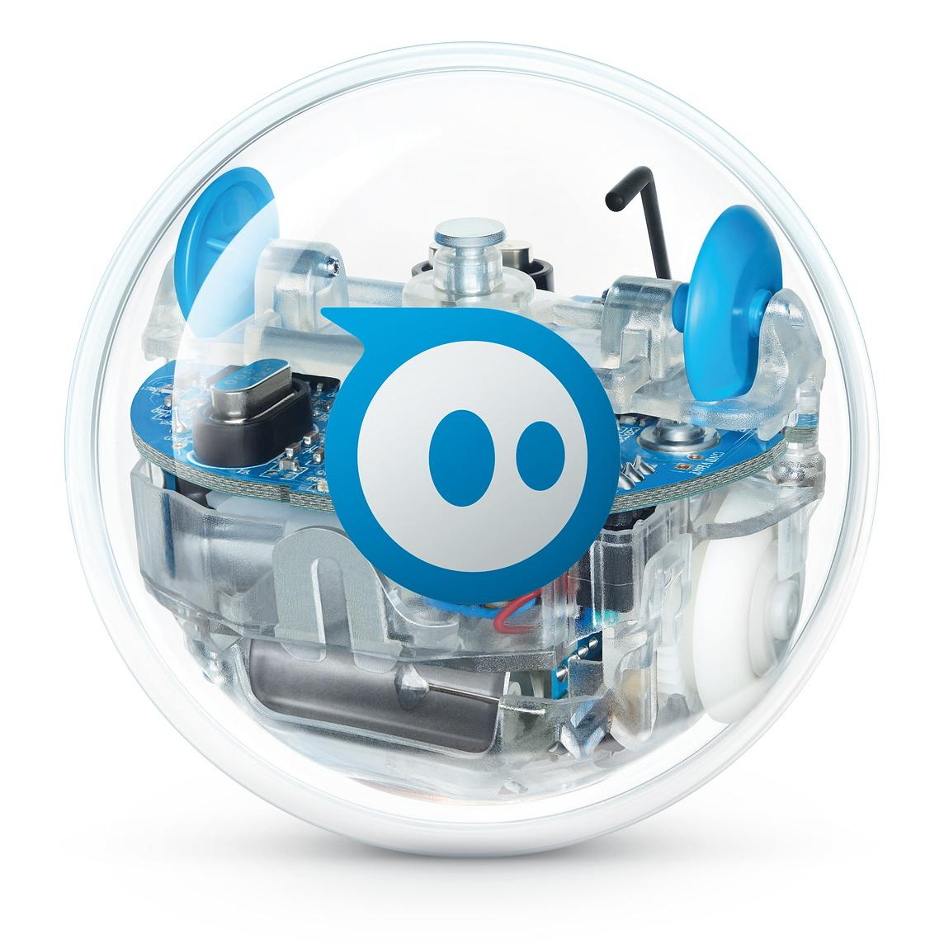
Software Robot Project
Kiki Kanik
Bryan Le
Veronica Marquez

Slide 2
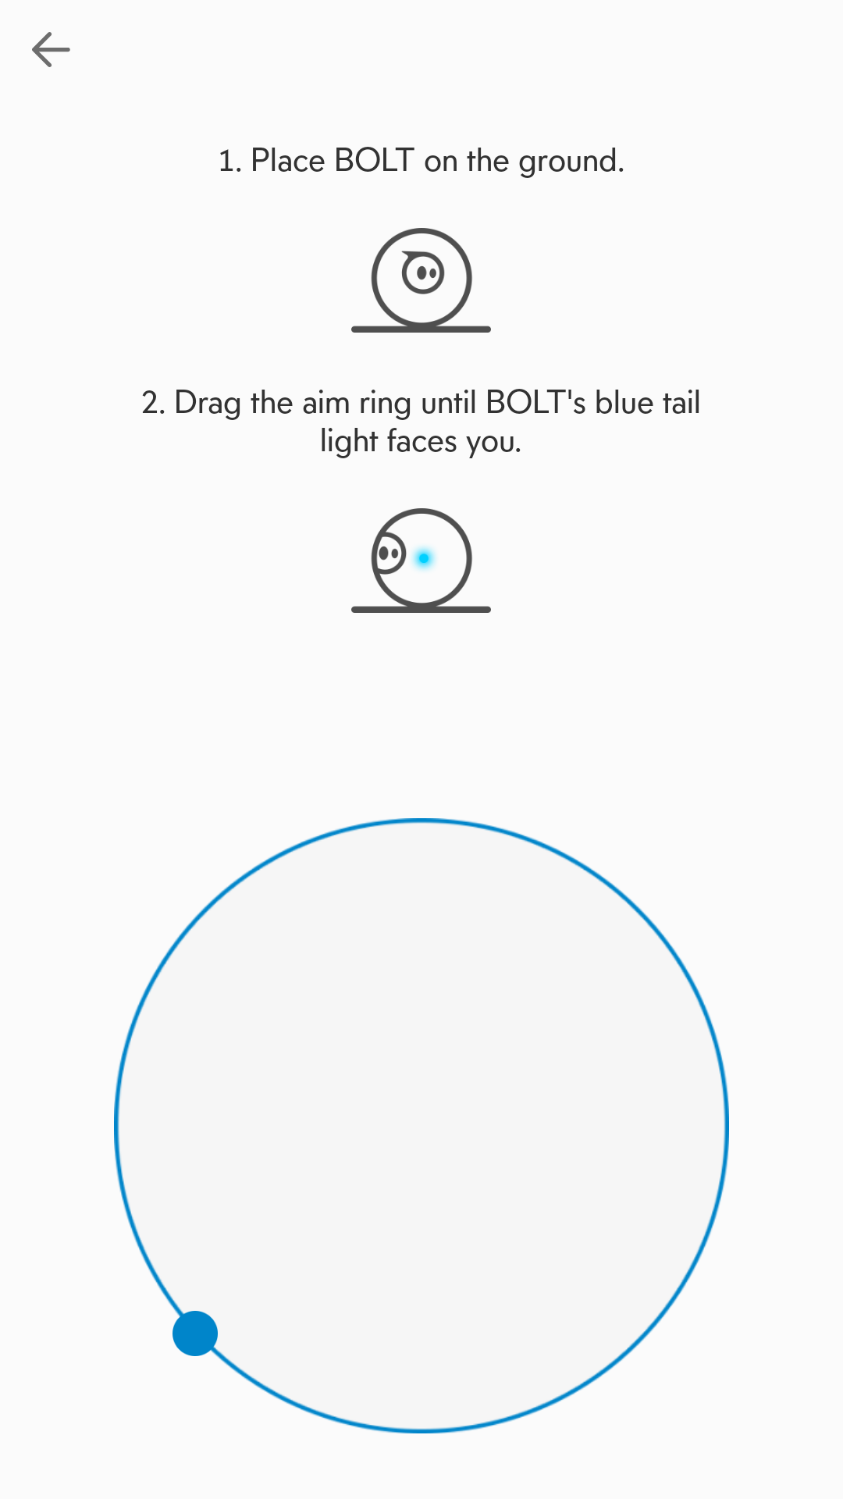
Some of the Challenges we faced were...
Aiming the robot correctly every time- Even if we were off by a few degrees the Robot would go entirely off course
Knowing the exact timing for the robot to run- When the battery isn’t full, the Robot wouldn’t perform as fast
Managing our time correctly -everyone is busy, and everyone has a life, and everyone has class outside of school, and we’re all commuters, so meeting up to talk and complete the required documents correctly and all together

Slide 3
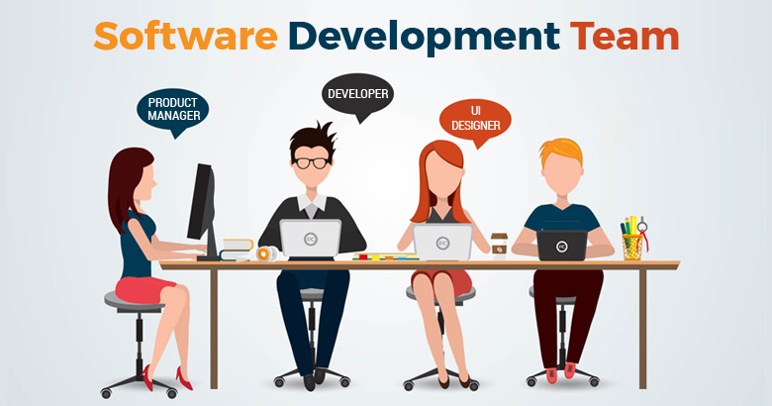
Each team member’s contribution:
Kiki Kanik was our Management
Bryan Le was our Assistant Manager
Veronica Marquez was our Coder, Tester

Slide 4

Through this project we have learned the importance of...
Teamwork
Time Management
Deadlines
The Requirements Gathering
The Designing Process
The Documentation Process
The Coding Process
User friendly abilities
Specifics

Slide 5

What would we have done differently?
Identifying and specifying the requirements of the code before making the code
Learn more about the Robot’s functions and familiarize ourselves with the Robot before creating the code. We created the code and then tried it on the Robot, but we couldn’t in real time do trial and error using the code and Robot until we took it out
Had a preliminary meeting to decide who would do what when

Slide 6
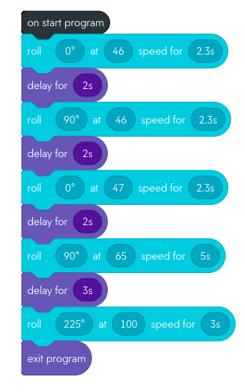
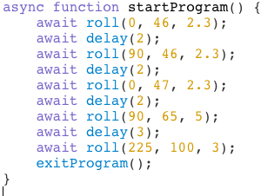
Our Code for Sprint 3:
Notes:
This code will change prob

Slide 7
In Conclusion...
It’s really stressful to be a software engineer! This project really made each of us understand the importance of working together, the responsibility of being a dependable teammate, and that we aren’t perfect. Sphero is a great robot, and is so much fun to use, but even it has many deficiencies and we have to learn to work around it. Sometimes our plans don’t work out, or something comes up, but at the end of the day we recognize that we are only human, and even though the robot listens to us, it goes off rail sometimes, and hopefully we won’t lose points for that happening!
Any Questions?

